Slide 1
CPE 301
Lab # 2 - Decoders

Slide 2
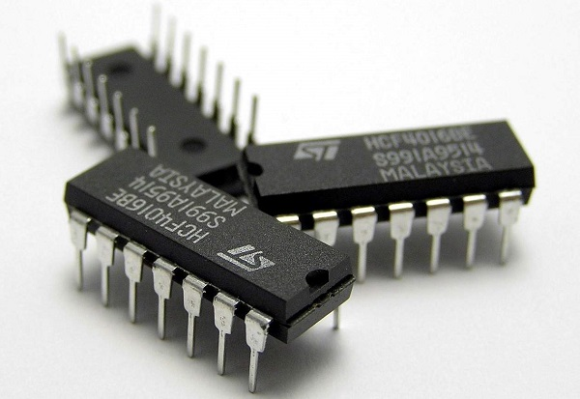
ICs
Integrated Circuits - a set of electronic circuits on one small flat piece of semiconductor (called "chip").
Normally made of silicon
Bunch of gates integrated in large numbers using tiny MOS transistors
Orders of magnitude smaller, faster, and less expensive than those constructed of discrete electronic components
We will be working with Decoders and Latches

Slide 3
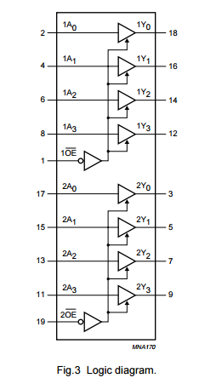
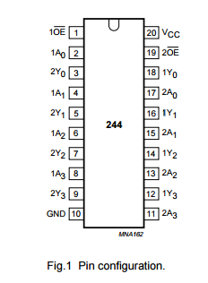
IC’s & Datasheets
Pin-out vs. Logic Diagram

Slide 4
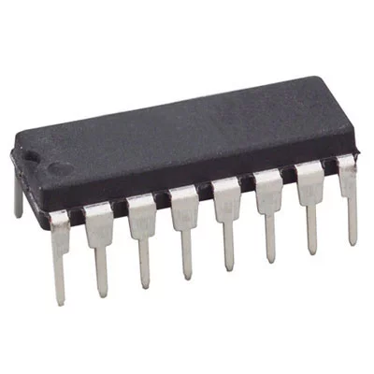
IC Data Sheets
Pin 8
Where to get them - Google it
How are the pins numbered?
Suggestion - Make sure they are the correct ICs by checking their numbers on the chip
READ THE DATA SHEETS REALLY CAREFULLY!
Pin 2
Pin ...
Pin 1
Pin 0

Slide 5
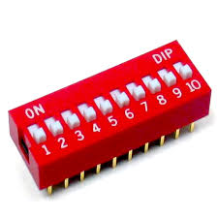
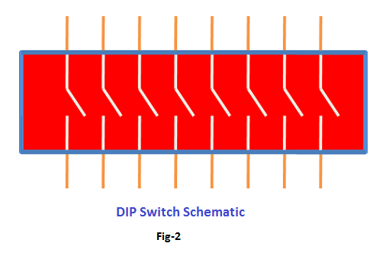
DIP Switches

Slide 6
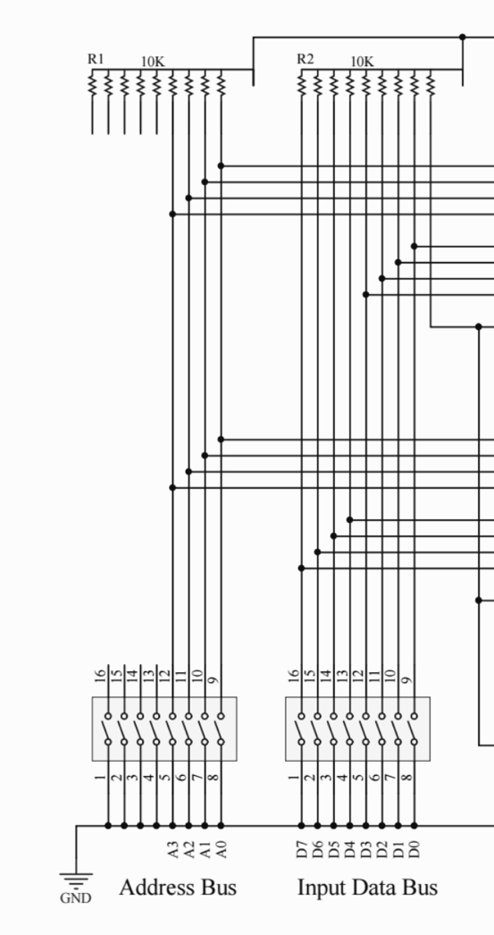
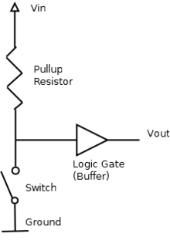
How to wire switches
Pull-up Resistors
What is the voltage at the pin when the switch is closed? Open?

Slide 7
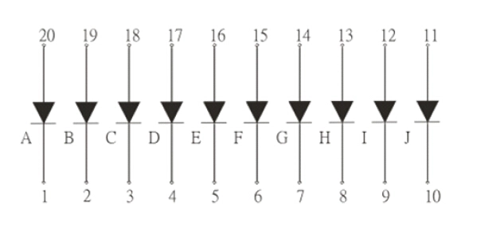
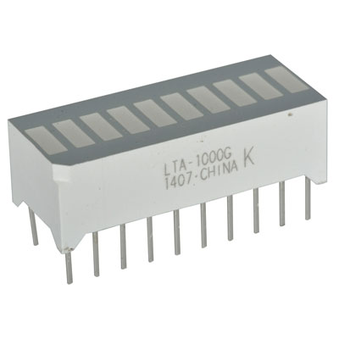
DIP Bar Graph LED
Make sure your Anode-Cathodes are correct

Slide 8
Circuits
Circuit - Decoders
Inputs A, B comes from DIP Switches
D0 = A’ * B’
D1 = A’ * B
A | B | D0 | D1 | D2 | D3
0 | 0 | 1 | 0 | 0 | 0
0 | 1 | 0 | 1 | 0 | 0
1 | 0 | 0 | 0 | 1 | 0
1 | 1 | 0 | 0 | 0 | 1

Slide 9
Tips
Built your circuit in increments
Test each IC
Verify your outputs in each step
Use a know input to test the output
Use the truth tables in the datasheet to verify your output.
Color code your jumpers
Use multiple breadboards on Tinkercad

